Slide 1

PREDICTING EMPLOYEES UNDER STRESS FOR PRE – EMPTIVE REMEDIATION USING MACHINE LEARNING ALGORITHM
MINI PROJECT
ON

Slide 2
Submitted to Guide : Mr.CH.V.V.NARASIMHA RAJU
Assistant professor Department Of INFORMATION TECHNOLOGY Project Batch - 1
V. ABHINAV SAI :207Y1A1201

Slide 3
CONTENTS:
Abstract.
Existing System.
Proposed System.
Requirements.
Advantages & Disadvantages
Architecture Diagram
Implementation.
Results.
Conclusion.
References

Slide 4
ABSTRACT:
This project is particularly relevant in today's world, where we can proactively identify employees at risk of high stress levels and implement strategies to alleviate their stressors. This not only benefits employees by improving their mental and emotional well-being but also optimizes organizational performance by reducing stress-related issues, ultimately fostering a healthier and more productive work environment.
Our project uses data visualization and machine learning to predict if an employee is likely to be stressed or not based on their data .

Slide 5
EXISTING SYSTEM:
Employee stress is a significant issue in workplaces, especially for professionals like human resource managers. Despite efforts to manage stress, it's essential to explore new ideas and research. This study draws insights from the field of organizational performance to provide fresh perspectives on dealing with job-related stress.
The research findings, based on data collected from a diverse group of employees across different industries, highlight the importance of positive factors like confidence, optimism, and resilience in coping with stress. It have limited capacity to predict stress levels effectively for a large number of employees simultaneously.

Slide 6
PROPOSED SYSTEM:
The main disadvantage of the existing system is its limited capacity to predict stress levels effectively for a large number of employees simultaneously. The current approach may not efficiently handle bulk predictions to overcome this we use Machine Learning Algorithms.
The proposed system, "Predicting Employees Under Stress Using ML Algorithms," uses data visualization and machine learning with six classification algorithms—naive Bayes, SVM, Logistic Regression, KNN, Decision Tree, and SGD. The Voting Classifier combines their strengths to improve prediction accuracy. This system proactively identifies employees at risk of stress, addressing their well-being and optimizing organizational performance.

Slide 7
Requirements:
Hardware Requirements:
Software Requirements:
Processor : Intel Core i3 and above.
RAM : 4 GB (min).
Hard Disk : 20 GB.
Key Board : Standard Windows Keyboard.
Mouse : Two or Three Button Mouse.
Operating system : Windows 7 and above.
Programming Language : Python.
Front-End & Designing : Html, CSS, Java script.
Back-End : Django-ORM.
Data Base : MySQL (WAMP Server).

Slide 8
Advantages & Dis Advantages
Advantages
Dis Advantages
Helps Employees: The project can tell if employees are stressed, so they can get support and feel better.
Better Work: It can make work smoother and more efficient, thanks to smart computer tools.
Faster Decisions: It uses numbers and computers to make decisions quickly and accurately.
Data Quality: stress predictions heavily depends on the quality of the input data.
Privacy Concerns: Collecting and analyzing employee data to predict stress levels may raise privacy concerns.

Slide 9
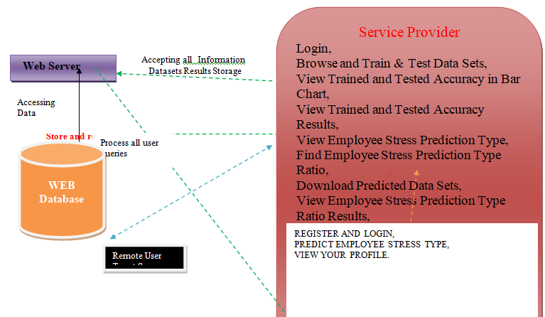
Architecture diagram :
Architecture diagram is a visual representation that illustrates the structure, components, and relationships within a system, providing a high-level overview of its design and functionality.

Slide 10


IMPLEMENTATION:
Required Libraries:
Django (v2.2.13): A high-level Python web framework Used for creating web applications with features like user authentication, database management, and more.
mysqlclient: A MySQL database connector Used for interacting with MySQL databases from your Python applications.
numpy: A library Used for mathematical and logical operations on arrays and matrices, which is particularly useful in scientific and data analysis tasks.
matplotlib: A library for creating static, animated, and interactive visualizations in Python like creating charts, plots, and graphs to visualize data.
pandas: A library for data manipulation and analysis. Used for working with structured data (e.g., data frames), data cleaning, transformation, and analysis.
scikit-learn: Used for building and training machine learning models for tasks like classification, regression, clustering, and more.
xlwt: A library for writing data and formatting information to Excel files from Python programs.

Slide 11
Steps for implementations:-
Step 1: Import all required libraries
Step 2: Start MySQL Server
Step 3: Compile the main file to generate a single HTTP link. (like: http://127.0.0.1:8000/)
Step 4: By clicking on that link, our project will open, allowing us to predict employee stress levels.

Slide 12
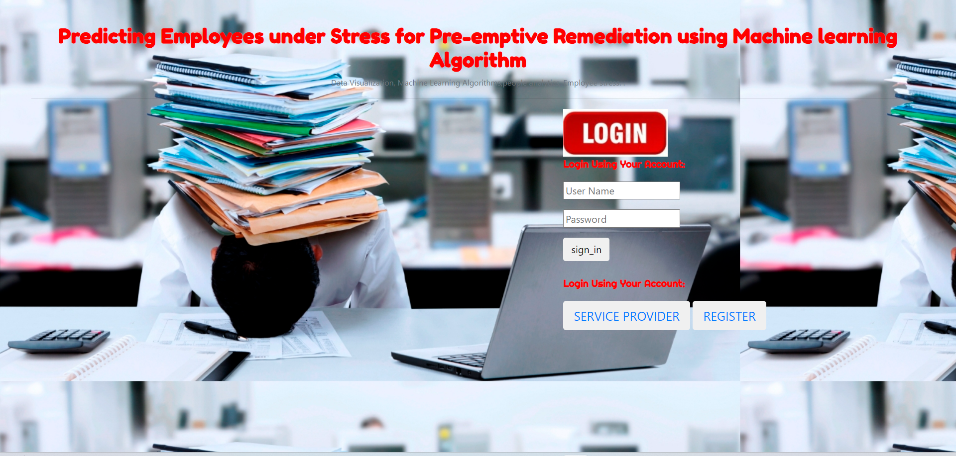
Results:
The Login page is the entry point for authorized users, where they provide their credentials (username and password) to access the system and its features securely.

Slide 13
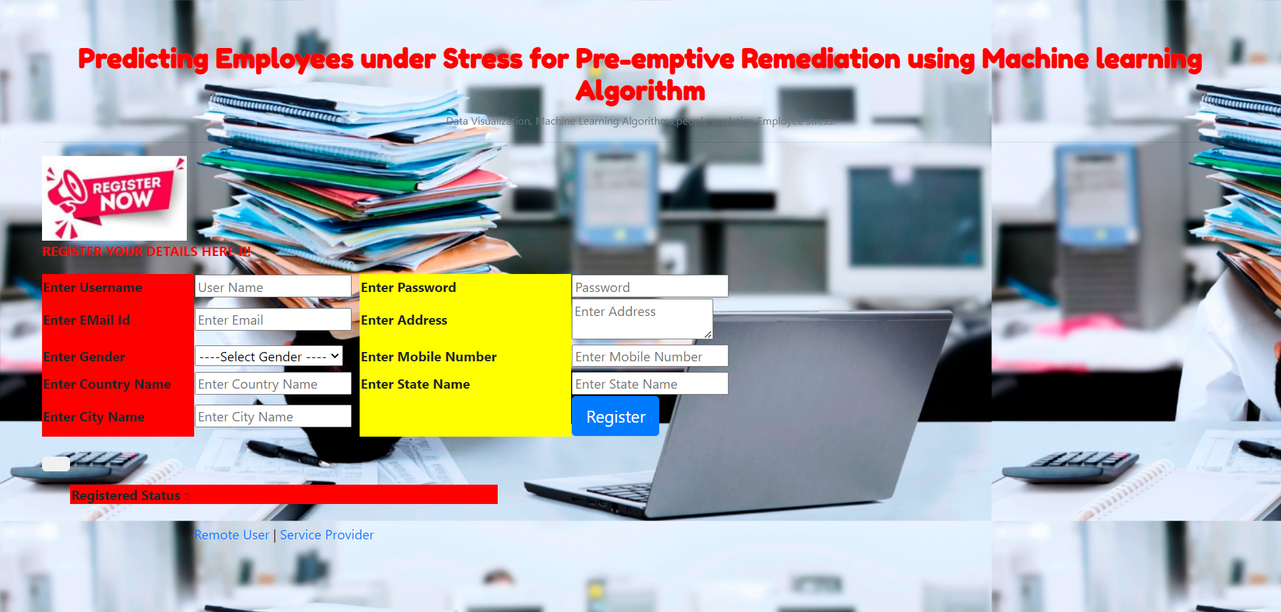
The registration page allows users to create new accounts by providing their personal information, enabling them to access the platform's features and services.

Slide 14
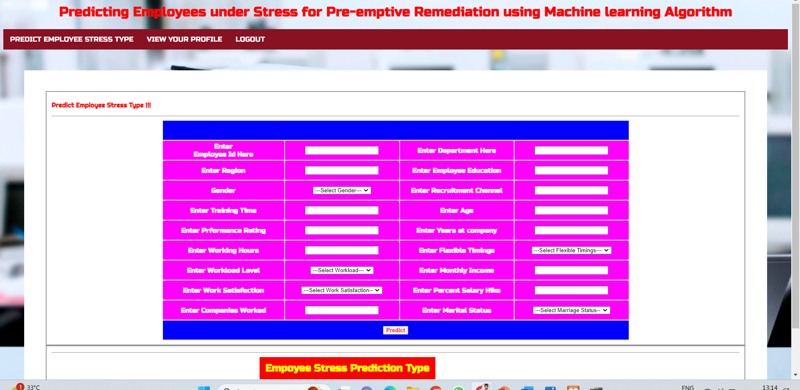
We have to enter data to predict the employee stress in remote user module

Slide 15
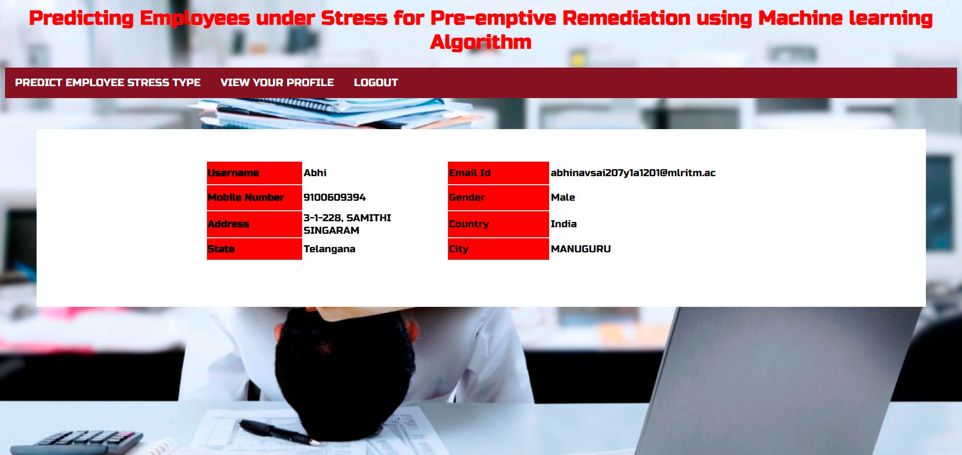
We can also view our Profile in Remote User

Slide 16
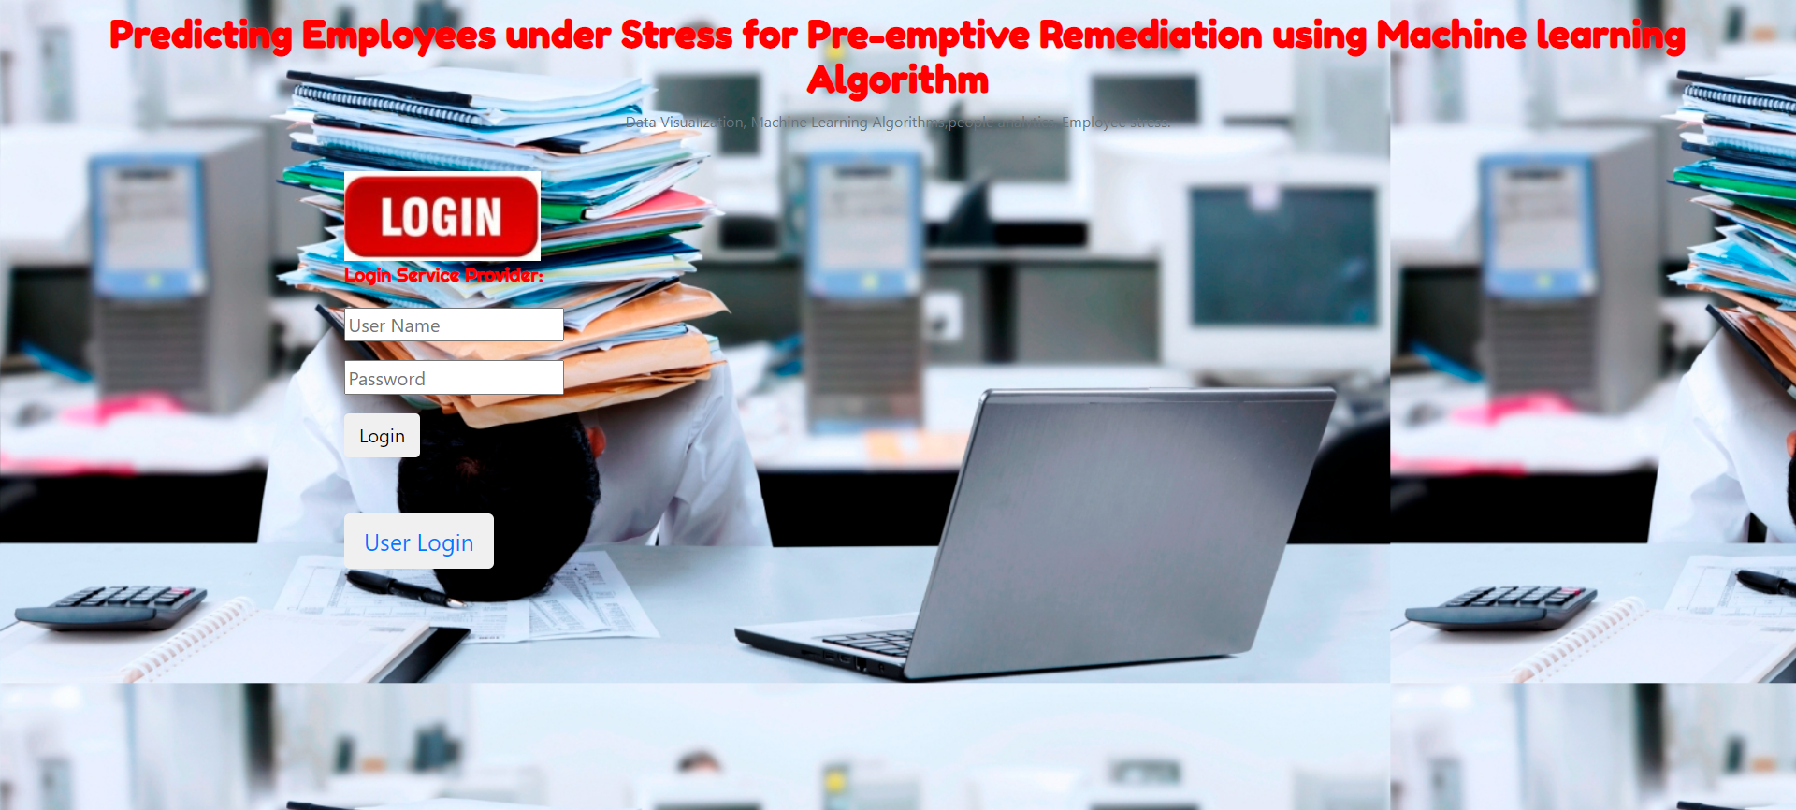
Service Provider:
The Login page is the entry point for Service Provider, where they provide their credentials (username and password) to access the system and its features securely.

Slide 17
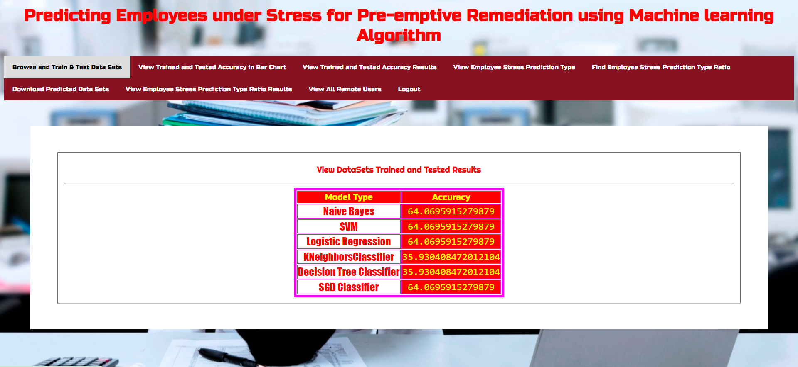
Browse and Train & Test Data Sets:
Admin can see the accuracy of the algorithm which we have used in this project.

Slide 18
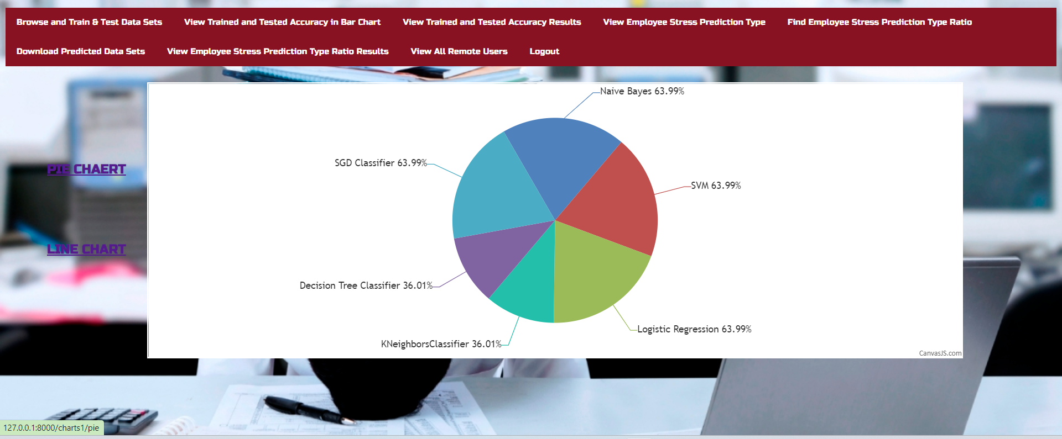
View Trained and Tested Accuracy in Pie Chart
Admin can see the accuracy of the algorithm which we have used in this project in pie chart.

Slide 19
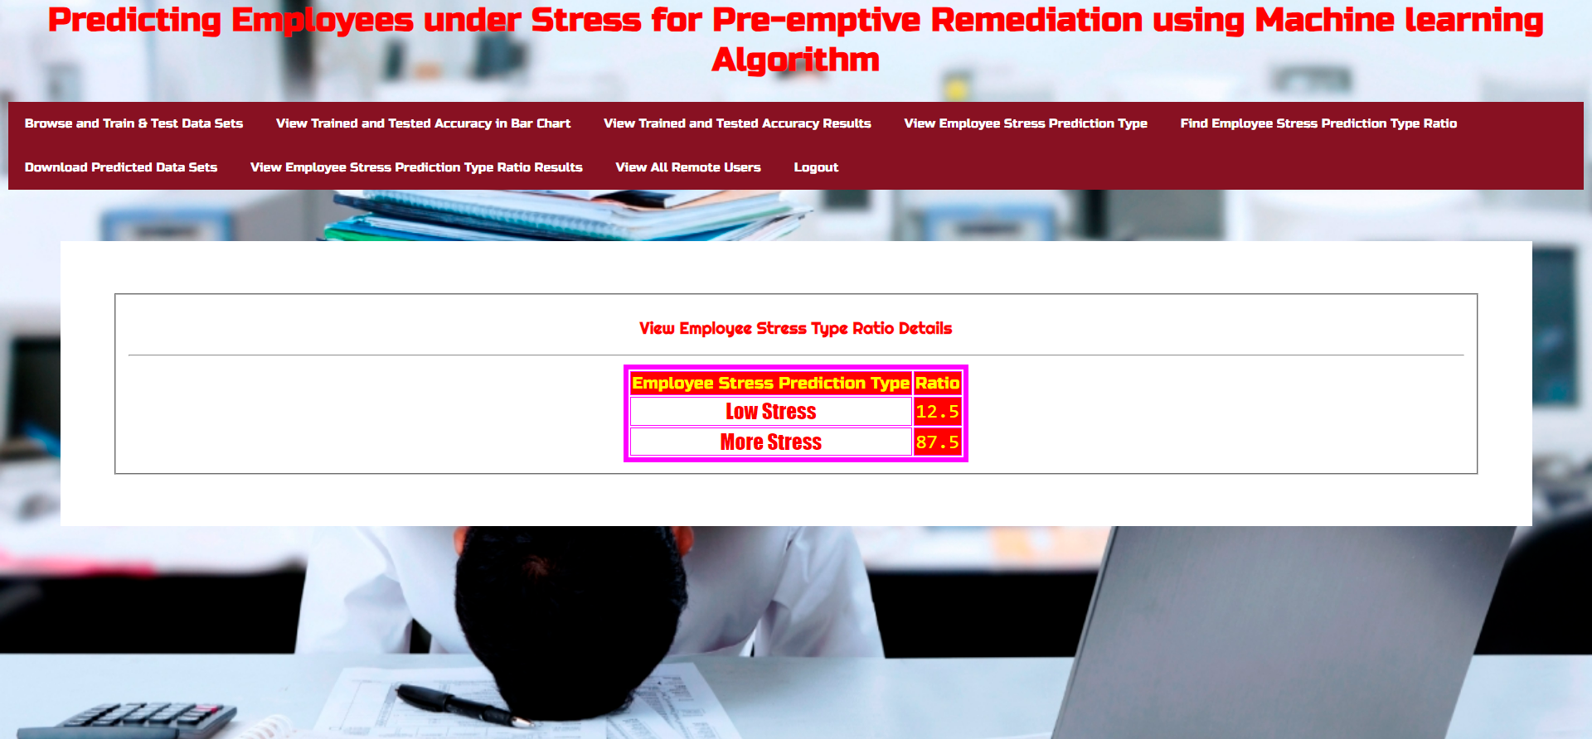
FIND EMPLOYEE STRESS PREDICTION TYPE RATIO
Admin can Find Employee Stress Prediction Type Ratio in Service Provider

Slide 20
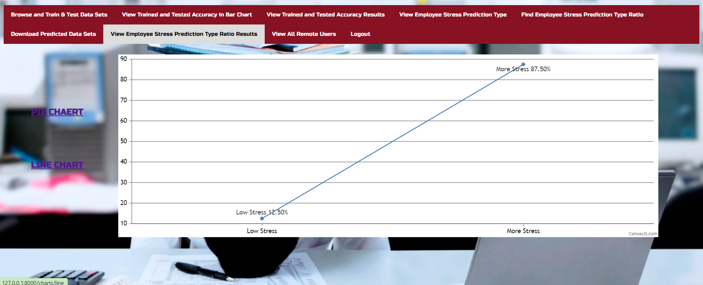
View Employee Stress Prediction Type Ratio Line Chart
Admin can see the accuracy of the Employee Stress Prediction which we have used in this project in line chart.

Slide 21
CONCLUSION:
In conclusion, our project focuses on predicting and addressing employee stress and Employ data visualization and machine learning to develop a model that identifies employees likely to experience stress, enabling pre-emptive interventions.
This approach not only enhances employee well-being but also optimizes organizational performance by mitigating stress-related challenges.

Slide 22
References:
[1] Shekhar Pandey, Supriya Muthuraman, Abhilash Shrivastava. The International Symposium on Intelligent Systems Technologies and Applications (2018)
[2] Ramachandran, R; Rajeev, D.C; Krishnan, S.G; Subathra.P. International Journal of Applied Engineering Research (2015),Research India Publications, Volume 10, Number 10
[3] Ramin Zibaseresht: How to Respond to the Ongoing Pandemic Outbreak of the Coronavirus Disease (COVID-19) (WHO- World Health Organization) (2020), ISSN 2349- 8870.
[4] Chen, Tianqi; Guestrin, Carlos; “XG Boost: A scalable Tree Boosting System”. Proceedings of the 22nd ACM SIGKDD International Conference on Knowledge Discovery and Data Mining, San Francisco, USA (2016).ACM. pp. 785-794.
[5] Jolliffe I.T. Principal Component Analysis, Series: Springer Series in Statistics, 2nd ed., Springer, NY, 2002,XXIX,487p.28 illus.ISBN 978-0-387-95442-4.

Slide 23

Thank You

